Slide 1

Corporate Finance 2. Planning and Budgeting
International Masters
Fall 2025 program
© Sylvie Appriou

Slide 2
Sessions calendar Group 1
Session nb | Date | Time |  | Contents
1 | Wednesday October 22nd | 09:00 - 11:00 | KB404 | Introduction
2 | Wednesday October 29th | 11:15 – 13:15 | KB602 | Home work review + class
3 | Wednesday November 5th | 09:00 - 11:00 | KB305 | Home work review + class
4 | Wednesday November 19th | 10:00 – 12:00 | KB305 | Home work review + class
5 | Wednesday November 19th | 15:30 – 17:30 | KB302 | Home work review + class
6 | Wednesday December 3rd | 09:30 - 11:30 | KB305 | Home work review + class
7 | TBD | TBD | TBD | Exam

Slide 3
Sessions calendar Group 2
Session nb | Date | Time |  | Contents
1 | Wednesday October 22nd | 14:15- 16:15 | KB403 | Introduction
2 | Wednesday November 5th | 11:15 – 13:15 | KB602 | Home work review + class
3 | Wednesday November 12th | 14:00 - 16:00 | KB301 | Home work review + class
4 | Wednesday November 26th | 13:30 – 15:30 | KB302 | Home work review + class
5 | Wednesday December 3rd | 14:45 – 16:45 | KB301 | Home work review + class
6 | Wednesday December 10th | 09:00 - 11:00 | KB403 | Home work review + class
7 | TBD | TBD | TBD | Exam

Slide 4
Sessions calendar Group 3
Session nb | Date | Time |  | Contents
1 | Wednesday October 22nd | 11:15- 13:15 | KB404 | Introduction
2 | Wednesday October 29th | 09:00 - 11:00 | KB304 | Home work review + class
3 | Wednesday November 12th | 11:45 – 13:45 | KB301 | Home work review + class
4 | Wednesday November 19th | 13:00 – 15:00 | KB606 | Home work review + class
5 | Wednesday December 3rd | 12:30 – 14:30 | KB301 | Home work review + class
6 | Wednesday December 10th | 11:15- 13:15 | KB403 | Home work review + class
7 | TBD | TBD | TBD | Exam

Slide 5
Course schedule and contents
Session 1
Introduction
Corporate Finance general concepts
Review of key Financial statements
Session 2
Cash vs Profit
Key Financial indicators
Planning and Budgeting introduction
Session 3
Planning and budgeting continuation
Budgeting Case study
Session 4
Case study correction
Cost Management
Capital investment introduction
Session 5
Capital investment continuation
Project value case methodologies
Session 6
Real life example : Project Value case
Introduction to Cost Accounting

Slide 6
Session contents
Finance and IT
IT is big money…
Charge back process
IT costs categories
Cloud Computing
Planning and Budget process
Cost Management

Slide 7
Finance and IT

Slide 8
Finance and IT
IT is big money !
If you work in the IT department of a 1B$ company then…
Your IT budget is anywhere between 40 m$ and 80 m$ (between 4 and 8% of Revenue)
IT spendings represent 50 % of the company Capital Expenditures
About 20% of budget is for « new things » (projects)
The other 80% is for running and maintaining production applications or « keeping the lights on »
The lifetime costs of an IT application are, on average, 5 times the initial project investment

Slide 9
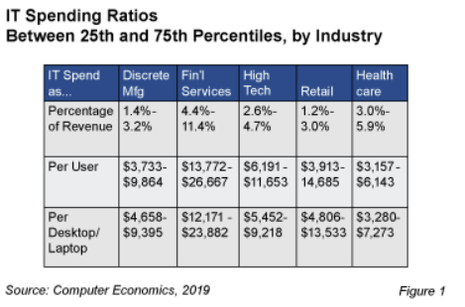
Finance and IT

Slide 10
What does IT do ?
20%
80%

Slide 11
Key IT financial processes
3 main IT financial processes
Planning and Budgeting
Linked to IT Strategic Plan
Operational support (HW, network, applications….)
Strategic projects, Other projects etc….
Cost Management
Tracking on ongoing costs vs budget
Forecasting for any required adjustement
Chargebacks
IT costs can be kept central or be « charged back » to other departments

Slide 12
IT Chargeback process (1/3)
Instead of being kept centrally, IT cost is charged back to users departments
Goals
Make departments responsible for their IT usage
Provide IT spendings visibility to top management
Allow IT to answer to unexpected customer demands with « Yes, we can do it but you will have to pay for it » Instead of « No, we can’t do it as it is not in our budget »
Pros
Reduced costs by cutting off unnecessary demands from users
Improved visibility to spendings
Increased accountability and controllability
Cons
Complex and controversial allocation rules
Heavy management process to collect and report on data
Make relationship between IT and other departments difficult mostly because of the questions of the fairness of the allocation rules used

Slide 13
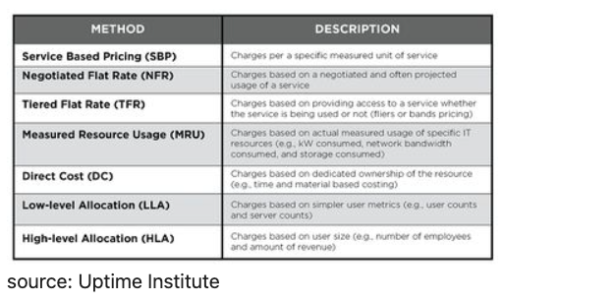
IT Chargeback process (2/3)
Allocation methods

Slide 14
IT Chargeback process (3/3)
IT chargeback challenges
Establishing a fair and practical chargeback policy
Partnering with business units for buy in
Collecting usage metrics is time consuming
Allocating IT costs efficiently
Pricing IT services
Providing detailed usage reports

Slide 15
Categories of IT costs

Slide 16
Categories of IT costs (1/4)
Travel and Entertainment
IT Overhead
People | Internal Staff Contractors Consultants
HW costs | Servers Network IT equipment
SW costs | Licences - Maintenance In house development
Services | Telecoms Outsourcing Cloud computing

Slide 17
Categories of IT costs (2/4)
Capex vs Opex
Capex : Capital expenditures
Asset on the Balance sheet
Amortized over the life of the asset
Amortization is an expense line on the P&L (no cash impact)
Opex : Operational expenses to run day to day business
An expense is Capex if an asset results from it….
Accounting rules
HW equipment is Capex except if « small » value
SW development and application configuration : Capex as this creates an asset
Post implementation / production phase : Opex as it is running day to day business
Note that SW licence maintenance is Opex vs licence is Capex
Preliminary project phase / feasibility study : Opex as no asset may result from it…

Slide 18
Categories of IT costs (3/4)
Accounting rules
Functional design is Opex and technical design is Capex
Production upgrades and enhancements are capitalizable while small changes and maintenance are not…
Development costs of one time data migration interfaces are not capitalizable because no asset result from it
T&E are Opex except if part of a capitalizable activity !
…There is room for interpretation : need to follow rules of the company

Slide 19
Categories of IT costs (4/4)
To be remembered :
HW is always Capex (except if of small value)
Services are always Opex
SW licences : Capex
Application development : Capex (except preliminary phases….)
Application maintenance : always Opex
T&E always Opex

Slide 20
Cloud Computing ITaaS

Slide 21
Cloud computing or ITaaS (IT as a Service)
Monthly rental fee for external services hosted in a data center
Per user for an application (SW as a Service, SaaS)
By capacity for a server (Infrastructure as a Service IaaS)
By usage for a SW development environment (Platform as a Service or PaaS)
SLA monitoring is essential
No capital costs (no HW purchased, no assset created…), only Opex
Impact on budgeting…
Usually, CIO prefer Capex as it has a lower impact on Opex..Pushes today’s costs to future costs
Could argue that the longer you keep a system, the more expensive rental becomes (depreciation has an end)

Slide 22
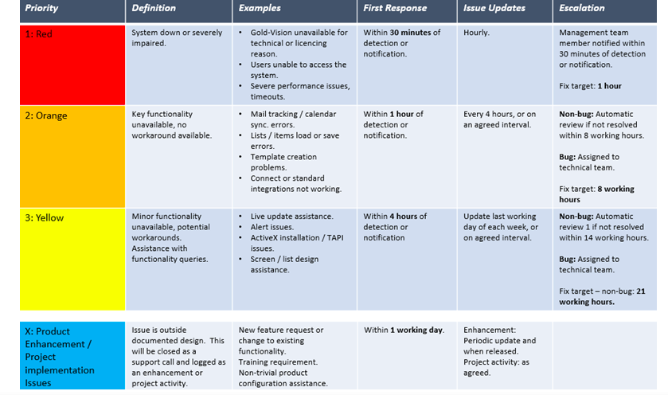
Cloud computing or ITaaS (IT as a Service)
SLA example

Slide 23
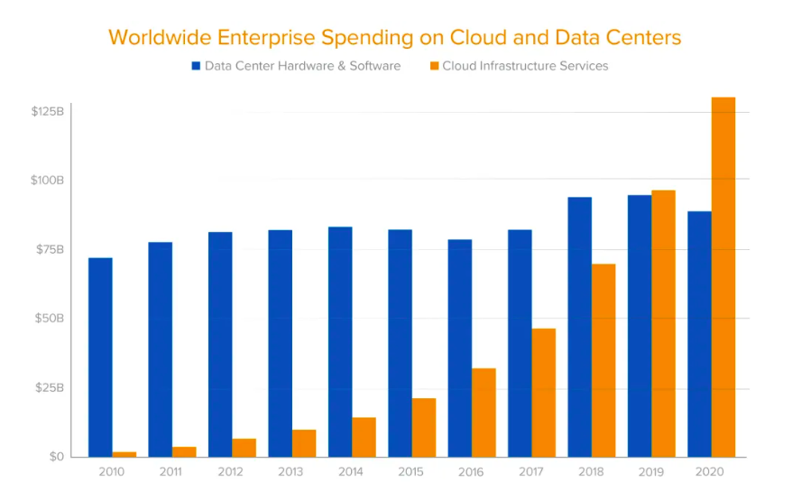
Cloud computing or ITaaS (IT as a Service)

Slide 24
Cloud computing or ITaaS (IT as a Service)
Why is Cloud computing so successful then ?
Less impact on Cash
No need to forecast future capacity
No « locked in » as with on premises data center
Pay only for the capacity you need at any point in time
Predictable
Can be scaled up and down
Flexibility to pull out at no cost
Should be more cost effective (vendors could realize better economies of scale than IT departments)

Slide 25
Planning and Budgeting

Slide 26
What is a budget ? (1/2)
A Financial plan for the upcoming year :
Broken down by month
Detailed spendings by cost items :
People (Full time employees, Contractors, Temp employees….)
HW costs (Servers, Network equipment…)
SW costs (Licences, SW maintenance….)
Services (Outsourcing, Coud Computing….)
Projects
….
A contract between department, project Manager or others and Top Management on what they are allowed to spend during the coming year…
Budget represents the means for a department, Project etc… to achieve their objectives

Slide 27
What is a budget ? (2/2)
Budgeting is a critical success factor to your job….
It ensures you have the means to achieve your objectives….
It is part of your Management activities….You will be assessed on it….

Slide 28
Budget format (1/4)
Financial template : Excel model
Lines = Cost items
Columns = Timeline
Col 1 : Previous Year spendings
Col 2 – 13 : Month 1 to 12 Budget
Col 14 : Sum Month1 to Month 12

Slide 29
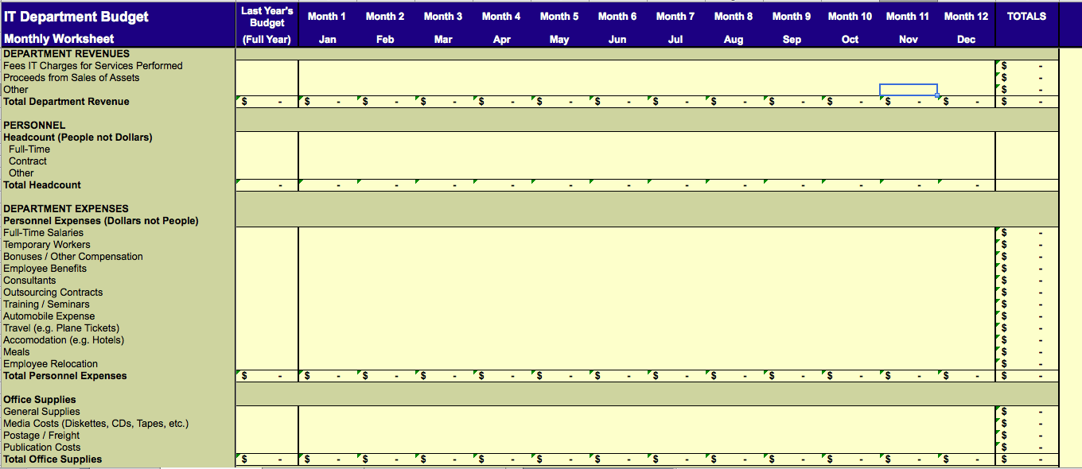
Budget model (2/4)

Slide 30
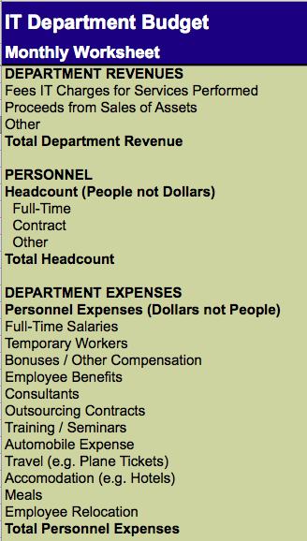
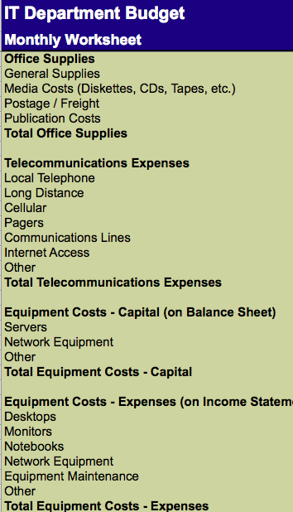
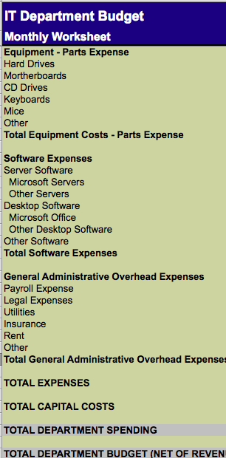
Budget model (3/4)

Slide 31
Budget model (4/4)
Model looks large and complex….
…but if we focus on what’s material (ie big numbers…), It is not so bad
Need to forecast :
On going operations
Projects
Material items in an IT budget :
Revenue, if any…
Headcount, ie employees : Permanent, Temporary, Contractors, Consultants
How many ?
Which cost ?
IT equipment : capex (Servers, Telecoms equipment…) and opex (desktops, etc…)
SW expenses : Licences, subscriptions
IT services (ex Cloud provider) or outsourcing contracts
Projects…
Others : office supplies, Employees related expenses, Payroll, legal services…Leave it to Finance to handle

Slide 32
Key elements to a budget?
Situation overview:
You were recently hired as IT manager at New Corp.
Your CEO asked you to prepare a first cut of your IT budget for 2023
Q1: What do you need to know before you start?
Q2: What elements will you include into your budget?
Q1:
Last year’s budget, corporate guidelines & rules
Your CEO’s strategy, expectations, priorities and guidelines
Details on your organization, scope, goals, team, etc…
Q2:
Hardware, Software, People, Services, Expenses, etc…
Assumptions and comments

Slide 33
Why plan & budget?
Q3:
Plan and demonstrate how you will contribute in achieving your organization objectives (maximize revenue, reduce capital costs, for example)
Helps you assess & negotiate the resources needed to deliver on your role, goals, projects
Basis for cost control and monitor progress, etc…
Q4:
Demonstrate your impact
Plan investments & prioritize your requests
Increase your chances of success by increasing your level of visibility and control
Reduce risks
Increase your ability to deliver an IT project on time and within budget, etc…
Q3: Why is it important to budget?
Q4: What will you be able to do with a budget?

Slide 34
Planning and Budgeting process
Vision / Mission
Strategic plan
Long term goals
Operating plan
Short term goals
SMART goals
Financial plan
Budget

Slide 35

Typical planning processes
Strategic Planning
Planning & Budgeting
Cost Mgt & Forecasting
Chargeback
IT PLAN
1 to 3 years
BUDGET
1 year
ACTUALS

Slide 36
Planning
Planning contributes to the objectives
A continuous process
Planning is part of managerial activities

Slide 37
Possible definition of planning
A basic management function involving formulation of a detailed plan to achieve optimum balance of needs or demands with the available resources.
The planning process:
Identifies the goals or objectives to be achieved
Formulates strategies to achieve them
Arranges or creates the means required
implements, directs, and monitors all steps in their proper sequence

Slide 38
Possible definition of planning
It means determining the organization's goals and defining the means for achieving them.
In short, planning is preparing for tomorrow, today. It's the activity that allows managers to determine what they want and how they will achieve it.
Not only does planning provide direction and a unity of purpose for organizations, it also answers six basic questions in regard to any activity:
What needs to be accomplished?
When is the deadline?
Where will this be done?
Who will be responsible for it?
How will it get done?
How much time, energy, and resources are required to accomplish this goal?

Slide 39
Benefits of planning
Strategic alignment
Improved decision making
Reduced risks
Increased return on investment
Optimized resource allocation and workload

Slide 40
Budget process
1. Review
The previous planning period
6. Evaluate
The effectiveness of the activity, feeding into future plans
2. Plan
The activity in a realistic and focused manner
5. Monitor
The activity
3. Secure and Allocate Resources
To achieve the planned goals
4. Implement
The planned activity

Slide 41
IT budget is part of a larger “company budget”
Starts with Sales and Revenue forecast for the coming year :
Must involve people in the field plus some market analysts
Look at the big customers and their buying intentions for the coming year
Look at historical Sales trends
Analyze « adressable » market : existing customers and prospects
Combination of above is likely to provide better resul
Plan must show reasonable balance between aggressiveness and conservatism and
…Be accepted by Sales people
…Be supported by manufacturing capacity

Slide 42
IT budget is part of a larger “company budget”
Once Sales / Revenue is determine, apply company’s financial model to get the rest of the P&L
Gross profit
% of expenses
Split of expenses : R&D, Sales and Marketing, G&A including IT
Net income
Budgeting is a « Trial and error » process
Key to measure Budget vs Forecast vs Actuals and assess Forecast accuracy : it is an on going task…
Variance analysis : Why do we see a variance ? What immediate action should we take ? What are the learnings for the next budget cycle ?

Slide 43
Writing your budget (1/6)
Prepare the plan
Make a list of all the things you think your organization will spend money on (a bit like a shopping list), such as salaries, rent, telephone, postage. Do not think of actual money at this stage.
You should consider:
One-off items such as, recruitment advertisements
Capital costs (fixed assets) for example, computer and office furniture will last for a few years
Running costs, which are ongoing expenses, for example, salaries, office space and telephones
Projects : which are ongoing expenses, for example, salaries, office space and telephones

Slide 44
Writing your budget (2/6)
Fill-in the figures
The more people you involve (for example, your Fin. controller, peers, internal partners and others connected with your organization) the more likely you will produce a good budget. Others can also help you to carry out research. Remember, no budget is 100% accurate.
The following questions will help you:
Was last year’s budget accurate?
Was anything forgotten?
Are there any changes in your activities?
Are there any other changes (such as an increase in rent)?
Will the cost of some things increase with inflation
Has your hierarchy agreed to give you the same amount of money as last year?

Slide 45
Writing your budget (3/6)
Make notes
It is not good enough to just guess the expenditure, or to put nice round figures for each of the headings. Once the budget has been approved, you will need to stick to it, so it is in your interest to make sure that it is as accurate and realistic as possible.
Document your assumptions. It will prove useful for budget presentations and revisions.

Slide 46
Writing your budget (4/6)
Revise the figures
Show your draft budget to to people inside your organization ( Team members, peers and management committee members):
Have you forgotten anything?
Are your assumptions and guesses fair and accurate?
Do you need more information? If so, where are you going to get it?
Do not panic as you are unlikely to get your budget right the first time round.

Slide 47
Writing your budget (5/6)
Approvals
The budget has to be approved by your management, incorporating any comments and changes that they want to make as budgets get consolidated up the management chain.

Slide 48
Writing your budget (6/6)
Monitoring & Revisions
As you move into execution, you need to track, monitor and report actuals (events, expenses, etc)
Your environment may change too
You will therefore need to regularly revise your budget

Slide 49
Budgeting methodologies
Baseline or incremental
Uses previous year budget / actual as a baseline
Does not encourage people to question previous assumptions, ways of working
Zero based
Start from scratch
More disciplined approach that encourage justification of all costs
Takes more time and effort…
In real life, budgeting is a combination of the 2 methods…

Slide 50
Two approaches to budgeting
Top-down
Bottom-up
Authoritarian
Centralized control
Simple
Top management
Shorter
Participative
Decentralized control
Complex
All levels of management
Longer
Which one is best? Why? In what situation?

Slide 51
Main goals of budget control
To establish the degree of progress to the achievement of short term plans
To allow delegation to occur without losing overall control
To provide a measure for allowing flexibility in operations
To establish short term plans and aid the organization’s planning process

Slide 52
Other aspects of budget control
Budget control defines:
Budget control levels
Spending authorizations
Acceptance that a project can start
Elements of individual performance

Slide 53
Functions of a budget committee (where available)
Co-ordinate the preparation of budgets which includes the issue of the budget manual
Issue timetables for the preparation of functional budgets
Allocate responsibilities for the preparation of functional budgets
Provide information to assist in the preparation of budgets
Communicate final budgets to the appropriate managers
Compare actual results with budget and the investigate variances
Continuously assess the budgeting and planning processes, in order to improve the planning and control functions

Slide 54
Budget approval
Key elements to check before your budget approval request:
Strategic alignment
Value creation
Resource optimization : time & money
Your track record
Complementarities with other may help
Other elements to consider:
You are competing against others for resource allocation
Support from others in the organization is key
Benchmarking (internally or externally) can help sell your case

Slide 55
How to win budget approval?
1. Align today’s budget to strategy. A long-term strategy provides a context for today’s expenditures. A three-year strategy can effectively demonstrate why developing “A” today is necessary to implementing “Z” in three years.
2. Perform a budget review. Arrange an annual or project-by-project budget review meeting to show how the allocated money has been spent. Use industry benchmarks to demonstrate that the department’s spending habits are in line and to give an opportunity to justify unexpected factors that affected the budget, such as changes in price or technology. Explain what worked out as planned, what didn’t and why.
3. Separate “need to have” from “nice to have.” Know the difference between essential investments and those that are merely helpful. Business-driven investments should already have this distinction. IT should make this difference clear in the budget for IT-driven projects – actually label each line item as either essential or non-essential. Spell out the risks and consequences of not having essential items.

Slide 56
How to win budget approval?
4. Create budget sub-sections. Separate the budget into projects (investments in new functions or infrastructure) and operational (day-to-day maintenance expenses). In lean times, evaluate investments based on business value returned. For operational expenses, look for ways to improve efficiency to reduce cost
5. Use a sharp pencil. Research purchase costs for each line item carefully. Use current market values and look for lower-cost alternatives. Establish a vendor management program at the organization to develop a mutually beneficial client/vendor relationship. Negotiate preferable terms and prices with vendors. Using proven negotiation tactics to receive best prices will make many IT leaders look like the very essence of thrift.
6. Get line-of-business support. Encourage line-of-business managers to vocally push for items in the IT department’s budget. Senior management loves an IT budget that supports business priorities (i.e., bolstering the bottom line or increasing competitiveness).

Slide 57
How to win budget approval?
7. Be credible. Past performance on designing and adhering to budgets will go a long way toward easing the approval process this time around.
Use industry benchmarks.
Don’t be overly optimistic in the projections – most companies simply can’t swallow cost overruns in the midst of a recession or downturn. Be realistic.
Be complete in the itemization – don’t forget maintenance and consulting.
Triple-check the figures. Erroneous numbers will paint an amateurish picture in front of senior management.
Justify every request and number in the budget itself. Match requested increases to the company growth rate. Keep operational budget increases in line with the rate of inflation.

Slide 58
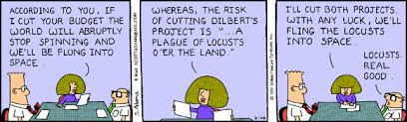

Slide 59

Cost management

Slide 60
Why implement cost management?
A third of IT projects carried out in the private sector runs between 10 and 20 percent over the original budget, according to a survey.
And one in four projects costs 50 percent more than it was expected to, according to the survey of 100 chief information officers, which also found that the typical large company is running 29 projects at any one time
According to the research, sponsored by software management company CA, the main reasons for overspending include poor forecasting, increases in project scope, and issues of interdependencies and conflicts between multiple projects
It said this isn't helped by the lack of visibility and control chief information officers have over their project portfolios. 39 percent of IT directors do not have clear visibility of projects and so do not know when they are close to running over budget

Slide 61
How to manage costs
Make sure the budget you have prepared includes all the key indicators you wish to control
Give responsibility for budget items only to individuals with the authority to control the outcome
Schedule regular reviews of budget performance
Review budgeted figures to identify cash flow or other problems which can be anticipated and tackled in advance
Compare other key ratios with historical figures to identify how performance is expected to improve or deteriorate
Carry out a sensitivity analysis to see what effect different outcomes could have on performance (“What if” analysis)
Focus on controlling items, which could have a significant effect on overall business performance

Slide 62
How to manage costs
As figures become available, compare actuals to budget and identify reasons for this variance
Determine how fixed costs differed from budget and whether any changes are likely to be permanent
Identify to what extent variances in revenues or expenses reflect differences in timing rather than performance
Take action to sort out underperformance, which can be controlled
Capitalize on unexpected favorable changes
Revise future budgets in the light of the information you now have

Slide 63
Elements of cost management
KPIs, KBIs, scorecards, dashboards
Actuals tracking
Reporting
Communication
Stake holder involvement
Budget reviews

Slide 64
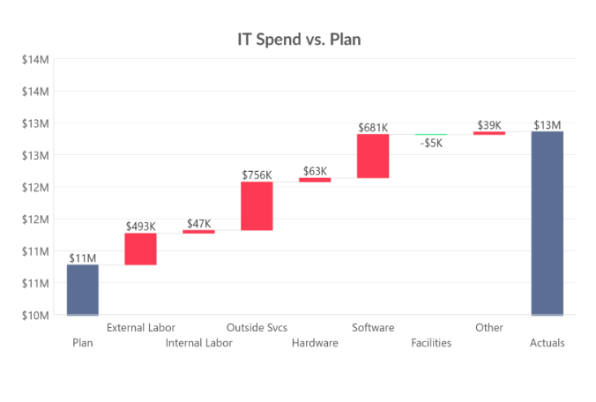
Dashboard example

Slide 65
Your IT Balanced Scorecard
Financial measures | Process measures
Customer measures | Learning and growth measures
Number of bugs reported or incident ratio
Average time / Maximum time to resolve incidents
Unplanned system downtime
System response time
Leadtime for Change request implementation
Backlog of change requests
Disaster recovery plan in place
Suppliers SLA performance
IT cost as a % of revenue or number of employees
$ split by activity (Infrastructure, Operational management, Projects, Others….)
Budget vs Actual gap
Project savings as % of investments (ROI)
% of budget spent on strategic initiatives
Customer satisfaction on IT operations or on IT projects
IT project adoption
% of IT projects delivered on time and on budget
Nb of support calls
% of calls solved on 1st call
Average waiting time for calls
Voluntary/involuntary IT turnover
% permanent employees / contractors
% of promotions
Number of innovation training hours per employee
Diversity ratios
IT employee satisfaction results
Implementation of lessons learnt

Slide 66
Benefits of cost management
Keep the connection & communication with your stake holders
Build credibility and reputation
Gain visibility on progress and deviations
Manage your resources against your budget
Continuous improvement

Slide 67
Cost management cardinal rules
Do:
Focus on key indicators which have a significant effect on performance
Use budgets to anticipate problems
Regularly review performance and find reasons for variances
Use budget control as a prompt to action
Revise budgets as more up-to-date information becomes available
Don't:
Confuse changes in timing with permanent changes to the levels of revenues or expenses
Ignore favorable variances without finding an explanation

Slide 68
Thank you!
See you next time

